Slide 1
Visualization of 3D Points Progress
Tay Truong
Weiting Liao
CSC664 Multimedia Systems

Slide 2
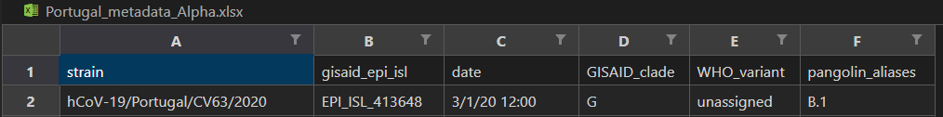
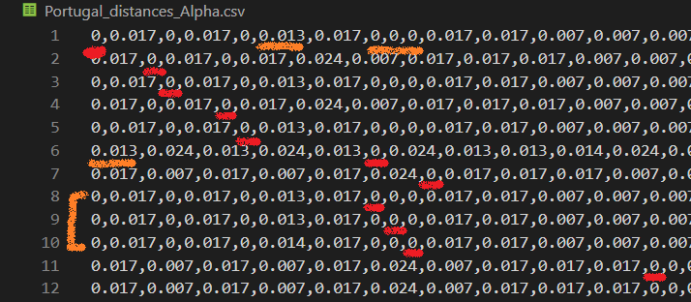
Data Being Used
-Cases of COVID-19
-xlsx & csv files
-5587 x 5587

Slide 3
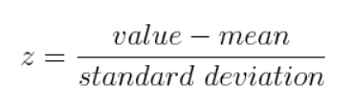
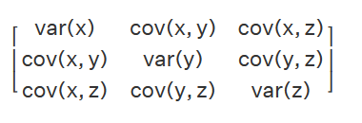
Processing Data: Principal Component Analysis
-Standardizing the data
-Limit range of initial values & give each
equal weight
-Compute Covariance Matrix
-Understand the relation between a
given pair of values

Slide 4
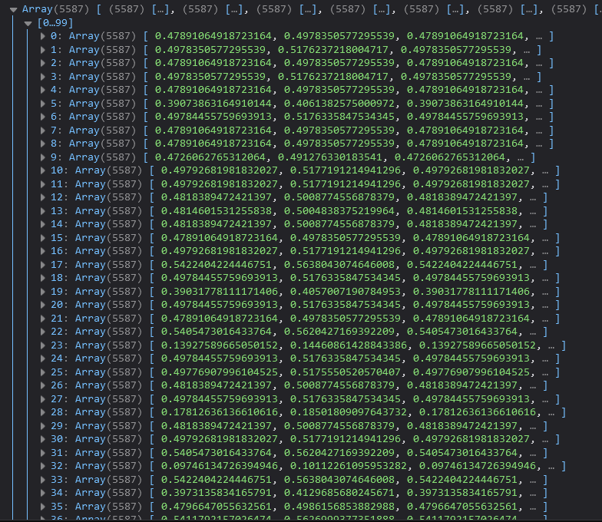
Covariance Matrix
-Some results

Slide 5
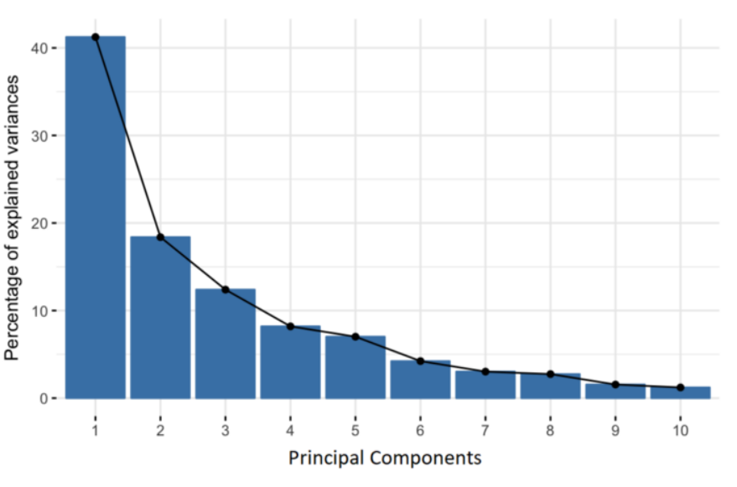
Principal Components
-Need to determine principal components, variables derived from the initial variables
-Most information compressed into 1st few components
-1 to 1 correspondence with data

Slide 6
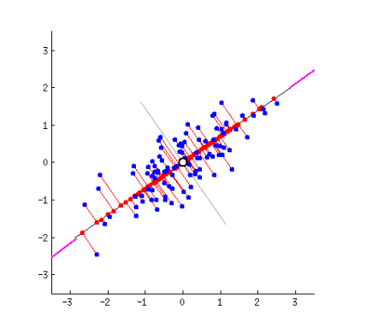
Eigenvectors & Eigenvalues
-Comes in pairs, 1 to 1 correspondence
-Eigenvectors are the directions with most variance (information)
-Eigenvalues give the amount of variance for each component

Slide 7
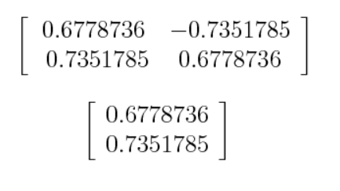
RECAST THE DATA
-Select the principal components and form the feature vector
-Use the feature vector formed using the eigenvectors of the covariance matrix
-Ideally keep 3-4 components

Slide 8
Source
-https://builtin.com/data-science/step-step-explanation-principal-component-analysis
-https://www.cuemath.com/algebra/covariance-matrix/
-https://www.cuemath.com/algebra/eigenvalues/

